Slide 1
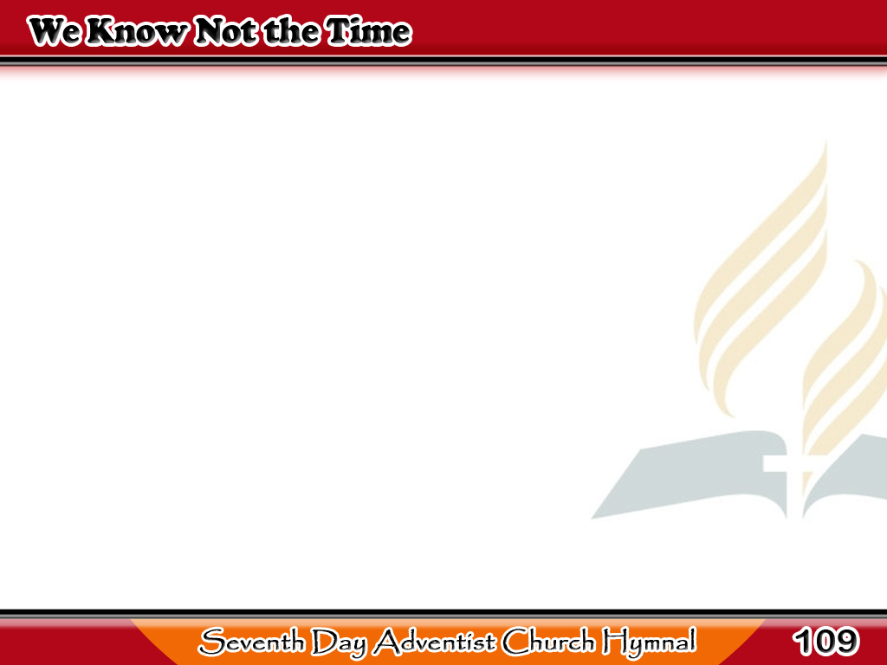
Ang Oras ng Pagdating Niya
We know not the time
when He cometh,
At even, or midnight, or morn;
It may be at deepening twilight,
It may be at earliest dawn.
1/3

Slide 2
Ang Oras ng Pagdating Niya
He bids us to watch and be ready,
Nor suffer our lights to grow dim,
That when He shall come,
He may find us
All waiting and watching for Him.
1/3

Slide 3
Ang Oras ng Pagdating Niya
-Refrain-
Waiting and watching,
waiting and watching;
Waiting and watching,
Still waiting
and watching for Thee.
1/3

Slide 4
Ang Oras ng Pagdating Niya
I think of His wonderful pity,
The price our salvation hath cost;
He left the bright mansions
of glory
To suffer and die for the lost.
2/3

Slide 5
Ang Oras ng Pagdating Niya
And sometimes
I think it will please Him,
When those whom
He died to redeem
2/3

Slide 6
Ang Oras ng Pagdating Niya
Rejoice in the hope
of His coming
By waiting and watching
for Him.
2/3

Slide 7
Ang Oras ng Pagdating Niya
-Refrain-
Waiting and watching,
waiting and watching;
Waiting and watching,
Still waiting
and watching for Thee.
2/3

Slide 8
Ang Oras ng Pagdating Niya
O Jesus, my loving
Redeemer,
Thou knowest
I cherish as dear
3/3

Slide 9
Ang Oras ng Pagdating Niya
The hope that mine eyes
shall behold Thee,
That I shall Thine
own welcome hear!
3/3

Slide 10
Ang Oras ng Pagdating Niya
If to some as a judge
Thou appearest,
Who forth from
Thy presence would flee,
3/3

Slide 11
Ang Oras ng Pagdating Niya
A Friend most beloved
I’ll greet Thee,
I’m waiting and watching
for Thee.
3/3

Slide 12
Ang Oras ng Pagdating Niya
-Refrain-
Waiting and watching,
waiting and watching;
Waiting and watching,
Still waiting
and watching for Thee.
3/3

